Slide 1
Investment Bot
Vishal Puppala, Bethel Kameni, Akaron Davis, Marvin Lee

Slide 2
Executive Summary
Create and interactive chatbot create a bespoke customer’s trading/investing experience based on the respective risk appetite
Use a Machine Learning Model to optimize momentum trading
MLP Classifier was chosen for the neural network for Machine Learning processing and optimization
Technical indicators (X):
VWOP
Exponential Moving Average (EMA) = 8
Predictions (Y):
Generated by Momentum
Investment returns
Observed better returns over time

Slide 3
Executive Summary
Use a Machine Learning Model to compare Actual versus Predicted Returns on what to invest in given a user’s risk tolerance
MLP Classifier was chosen for the neural network for Machine Learning processing and optimization
Technical indicators (X):
VWOP
Exponential Moving Average (EMA) = 8
Predictions (Y):
Generated by Momentum
Investment returns
Observed better returns over time

Slide 4
Executive Summary (cont’d)
Chatbot: gather information from our client to pass onto the ML model
Base information:
Firstname
Age: between 18-65
Email
Investment Amount: $10000
Time Horizon: 10 years
Information pertinent to the Machine Learning processing
Risk level determines what to invest in
Low: S&P
Medium: Single name stock (e.g., Apple)
High: Penny stock (East Side Distilling) -> chosen for this demonstration
All risk levels will be submitted in the repository

Slide 5
Presenter order
Marvin Lee: demonstrate the Chatbot capability
Vishal Puppala: Machine Learning demonstration
Bethel Kameni: Analysis of the Machine Learning results

Slide 6
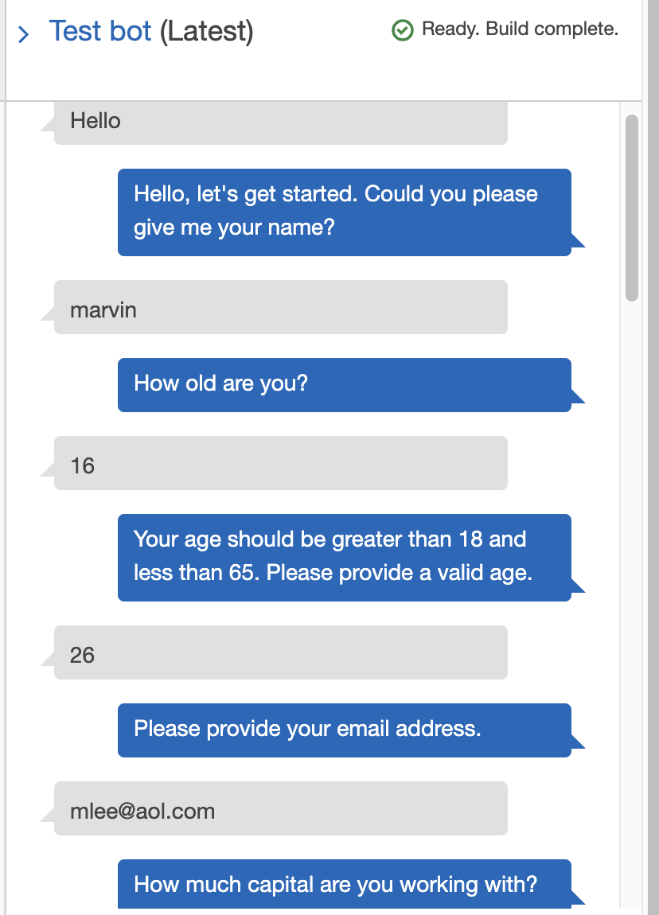
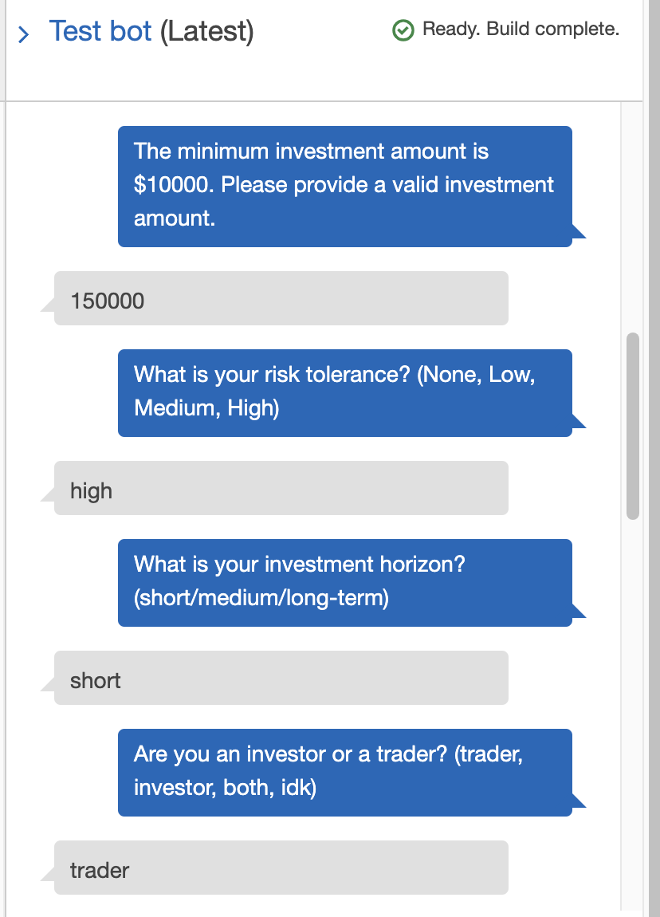
Amazon Lex Bot - Demonstration
buildProfile (intent)
Name
Age
Email Address
Investment Amount
Risk Tolerance
Time Horizon
Type of user (trader/investor)

Slide 7
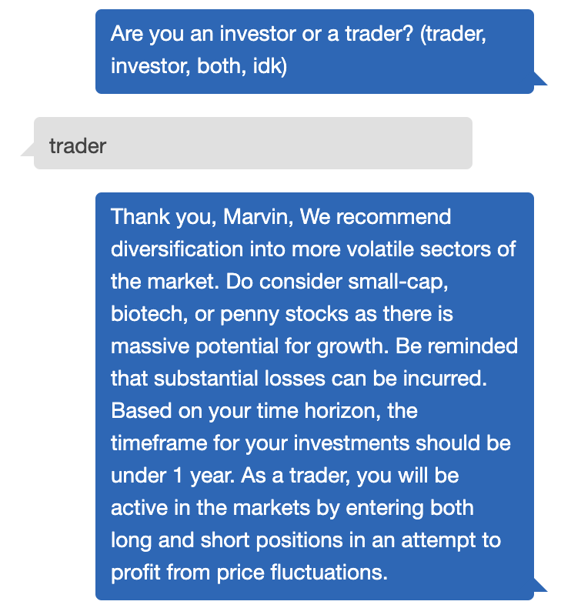
buildProfile
Name: Marvin
Age: 26
Email: mlee@aol.com
Investment Amount: $150,000
Risk Tolerance: High
Time Horizon: Short-term
User Type: Trader

Slide 8
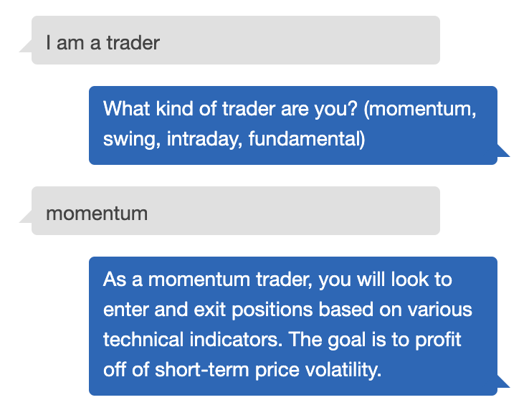
GOING DEEPER
What is your trading strategy?
Is it based off news (company earnings, analyst reports, FOMC announcements)?
Is it based off technical indicators (moving averages, RSI, MACD)?
Is the strategy quantifiable?

Slide 9
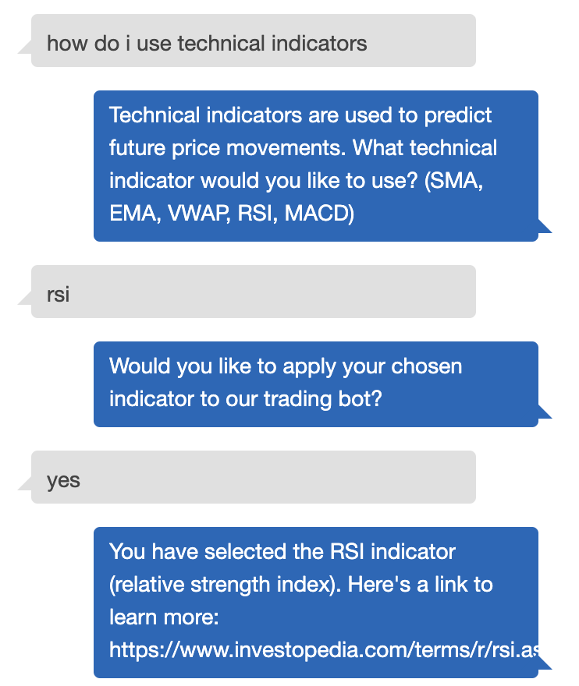
Technical Analysis
What indicators would the user like to use?
Would the user be open to using our trading bot?
Would our trading bot help them?
An investor that just ‘buys and holds’ would not have much use for our bot as he would be more passive and not care about the VWAP or if the company he invested in is under the 21-day moving average
Provide them with sources to learn more about technical indicators

Slide 10

Demonstration Video

Slide 11
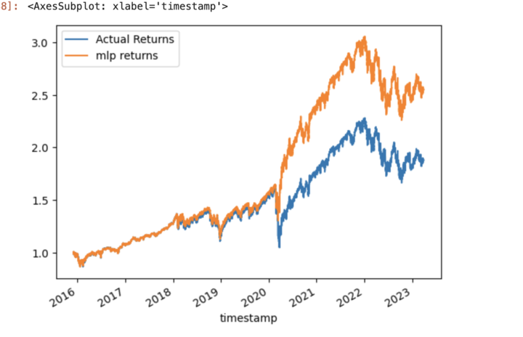
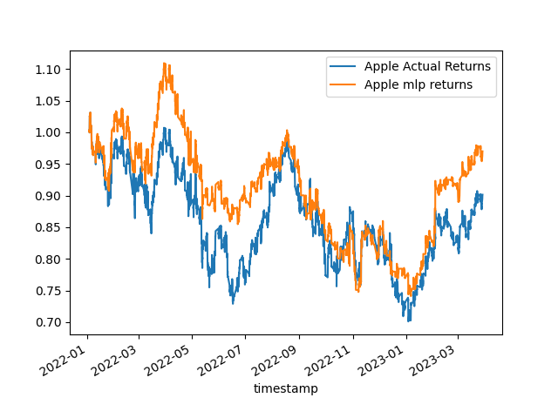
Machine Learning Under the Hood
MLP Classifier
Feature set were technical indicators generated from OHLCV dataset and imported from Finta
Target Variable is generated from a momentum strategy
Architecture decoupled from frontend
Allows for decrease in latency
More efficient Communication
Mid Risk
Low Risk
Notes:
Architecture tradeoff:
-decrase in latency and more efficient communication between user and application without delays
-lack of integration could be a detriment though if the user desires integration of real time data in the ml workflow
Graphs:
Here are some visual aids to demonstrate how utilizing machine learning can increase returns.

Slide 12
Analysis
Why did we chose MLP
Optimization
Results
Different type of risk associated client profile

